Slide 1


FPT SOFTWARE
Machine Learning Fundamentals
10/02/18

Slide 2
Supervised Learning
Lecture 2: Supervised Learning
Outline:
Regression and Classification
Inductive Learning
Decision Trees
Bayesian Learning
Neural Networks
Model Ensembles
Learning Theory
Support Vector Machine
Exercise

Slide 3
Supervised Learning
Lecture 2: Supervised Learning
Outline:
Classification and Regression
Inductive Learning
Decision Trees
Bayesian Learning
Neural Networks
Model Ensembles
Learning Theory
Support Vector Machine
Exercise

Slide 4
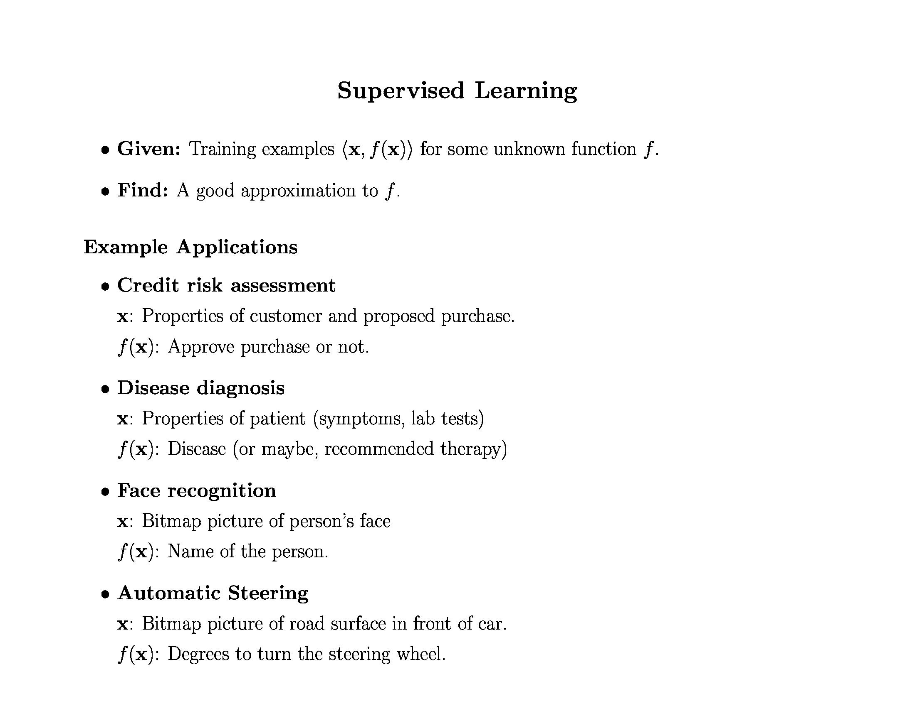
Inductive Learning

Slide 5
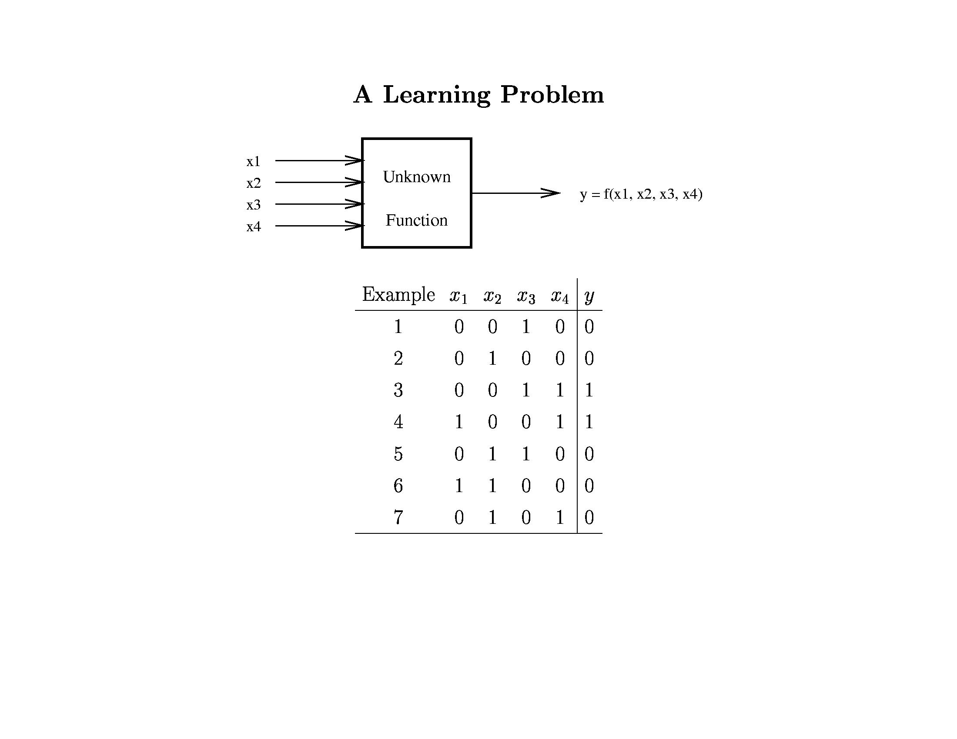
Inductive Learning

Slide 6
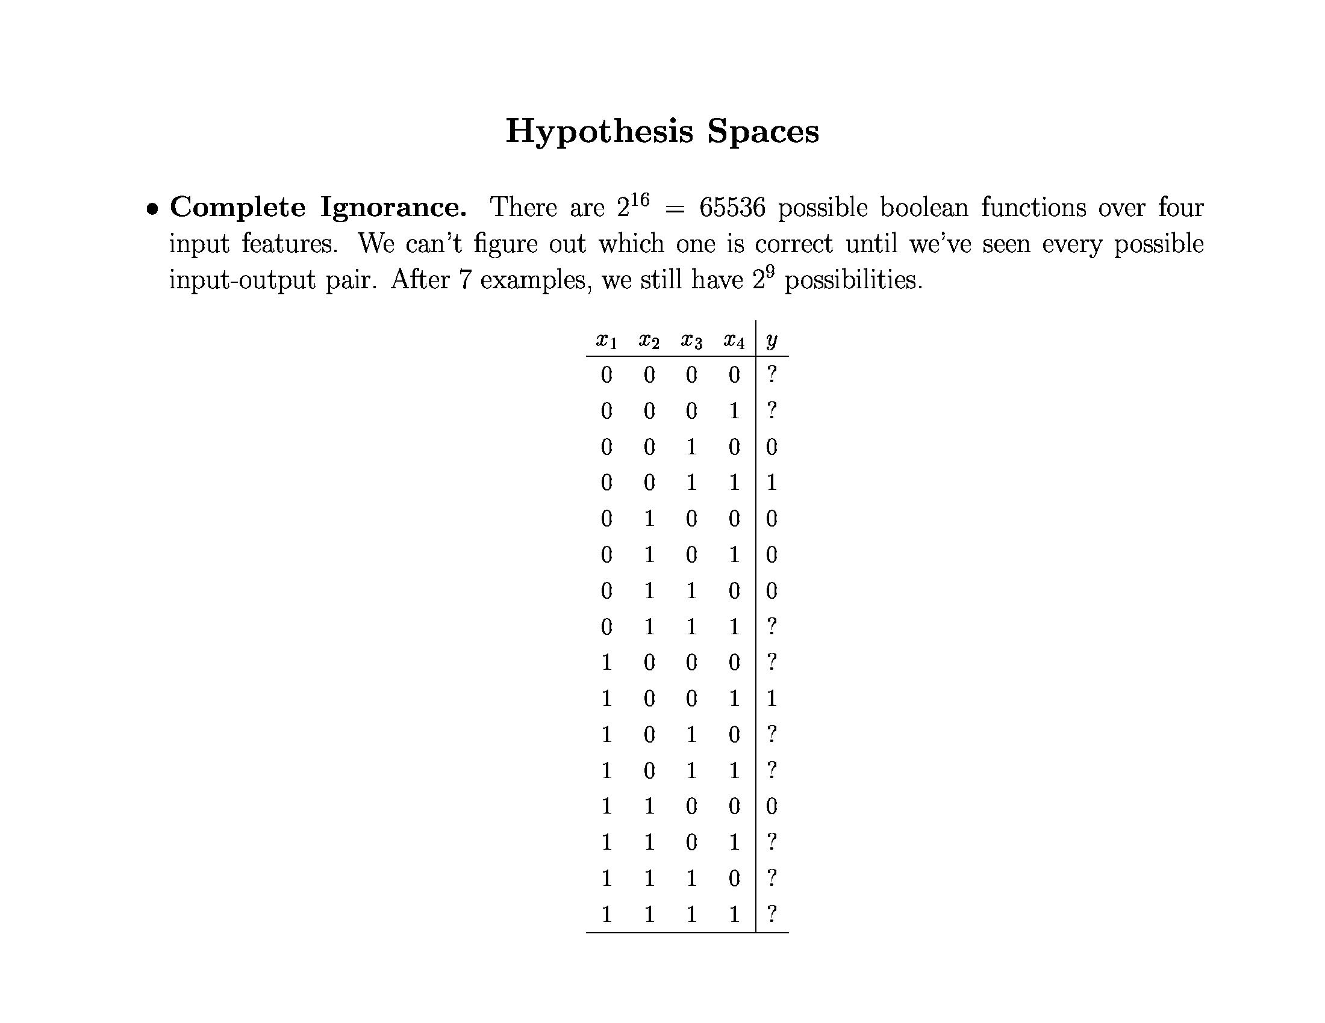
Inductive Learning

Slide 7
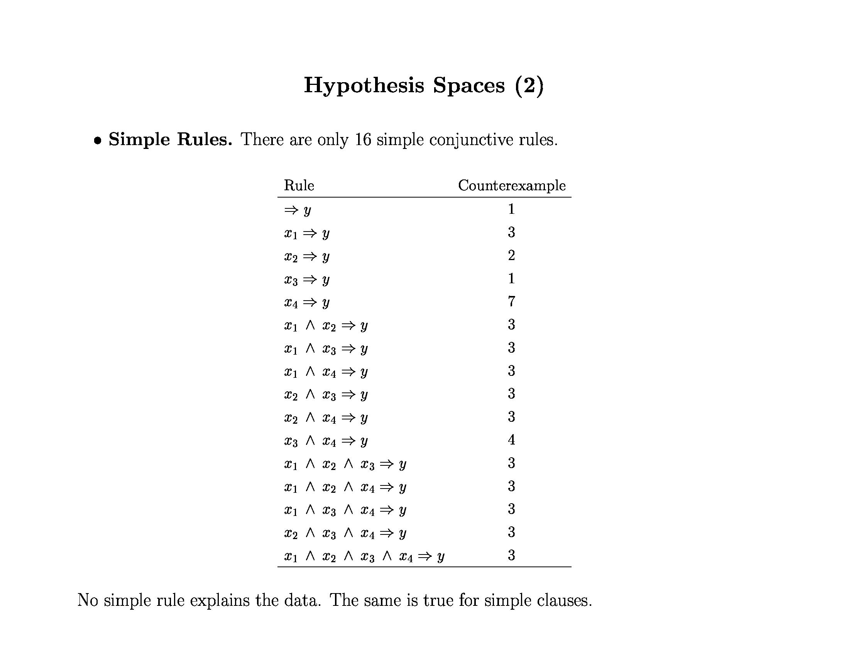
Inductive Learning

Slide 8
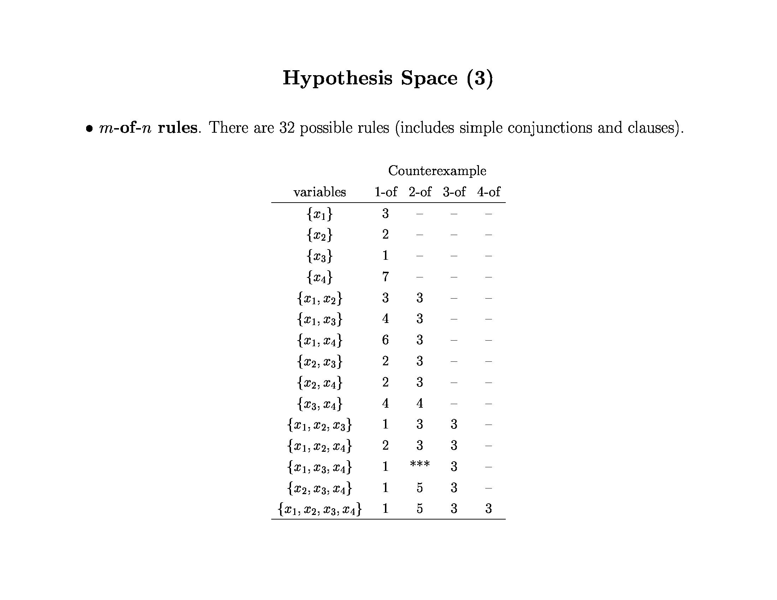
Inductive Learning

Slide 9
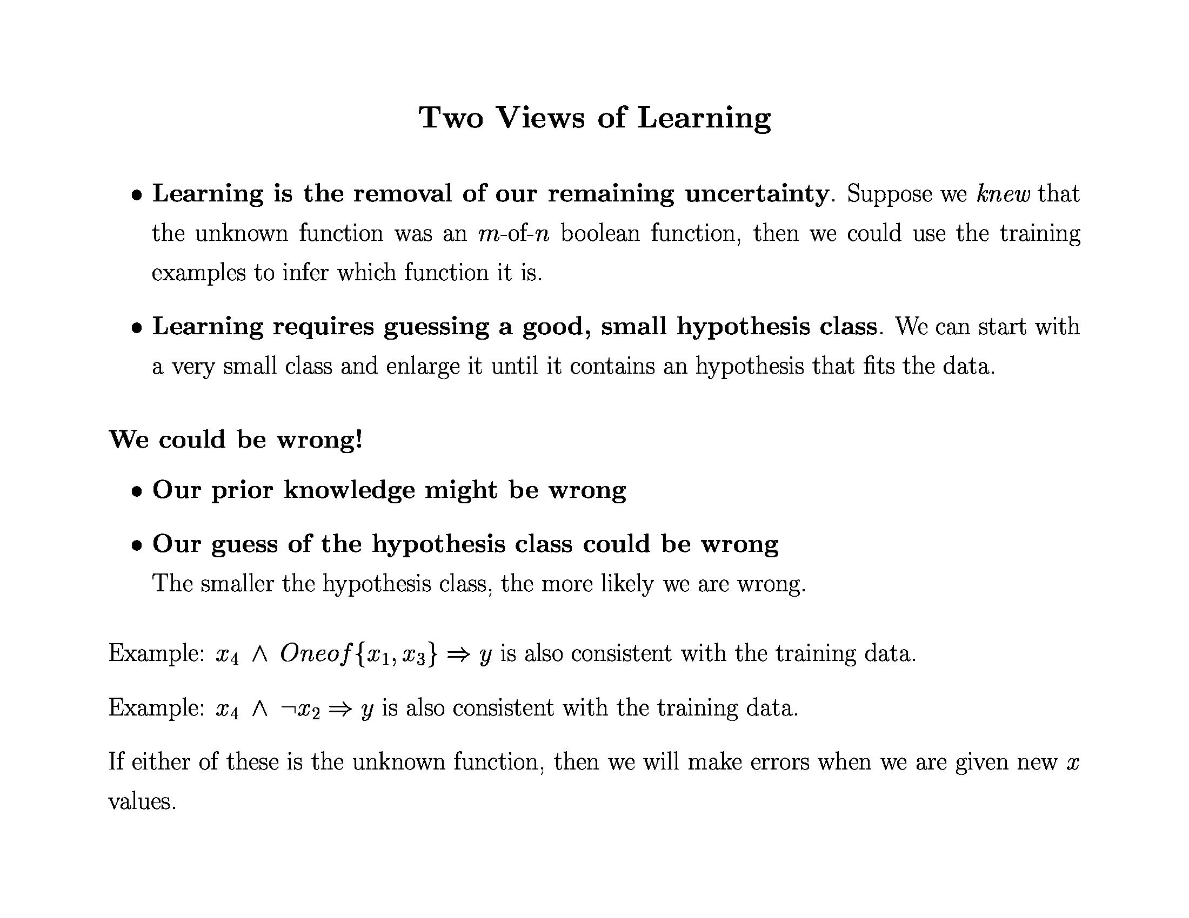
Inductive Learning

Slide 10
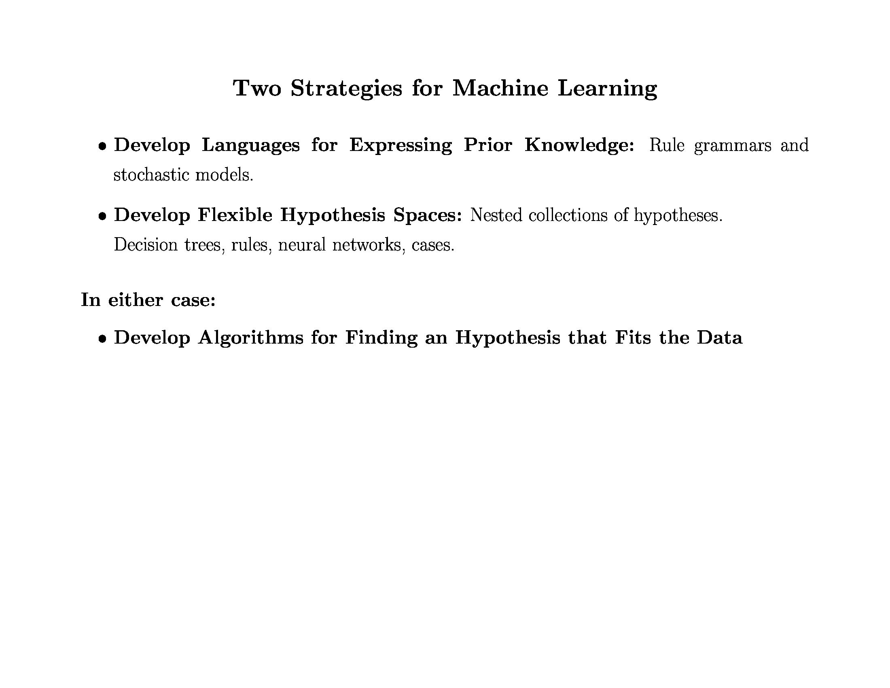
Inductive Learning

Slide 11
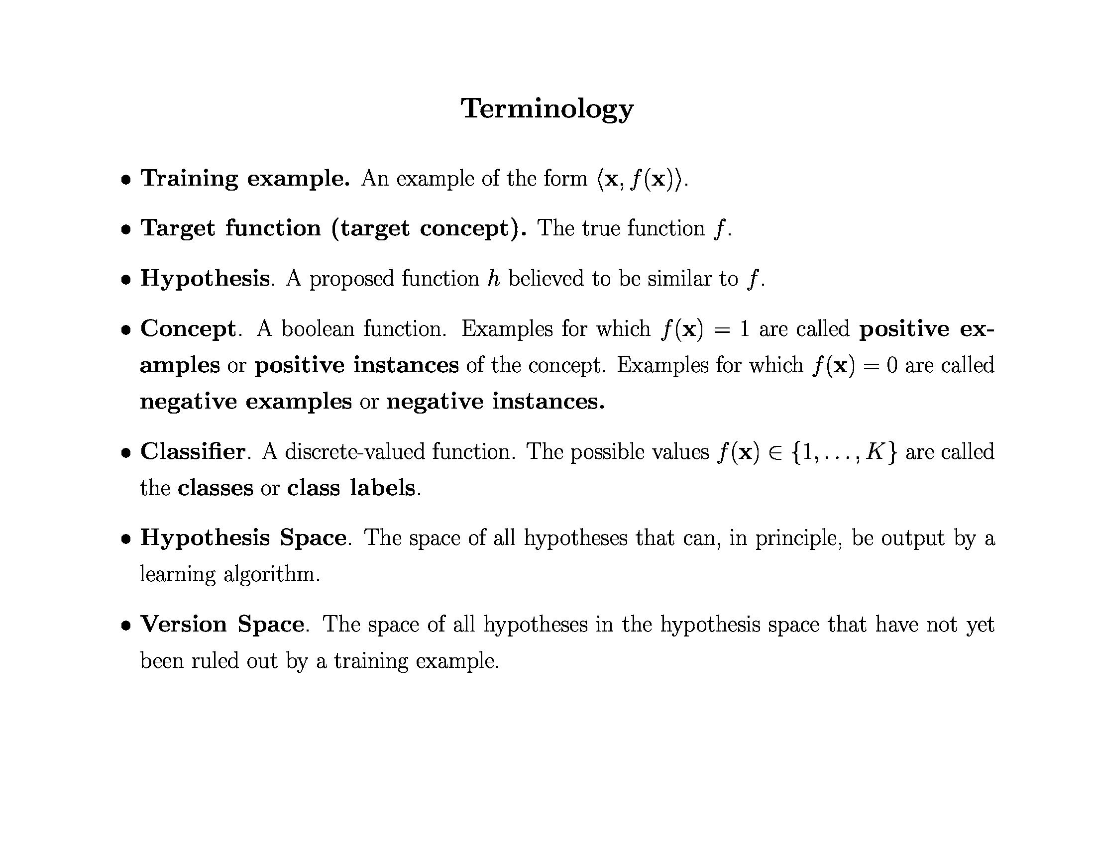
Inductive Learning

Slide 12
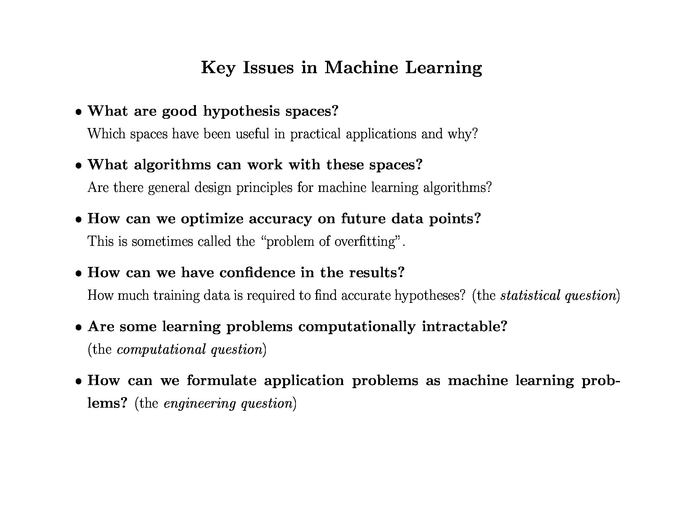
Inductive Learning

Slide 13
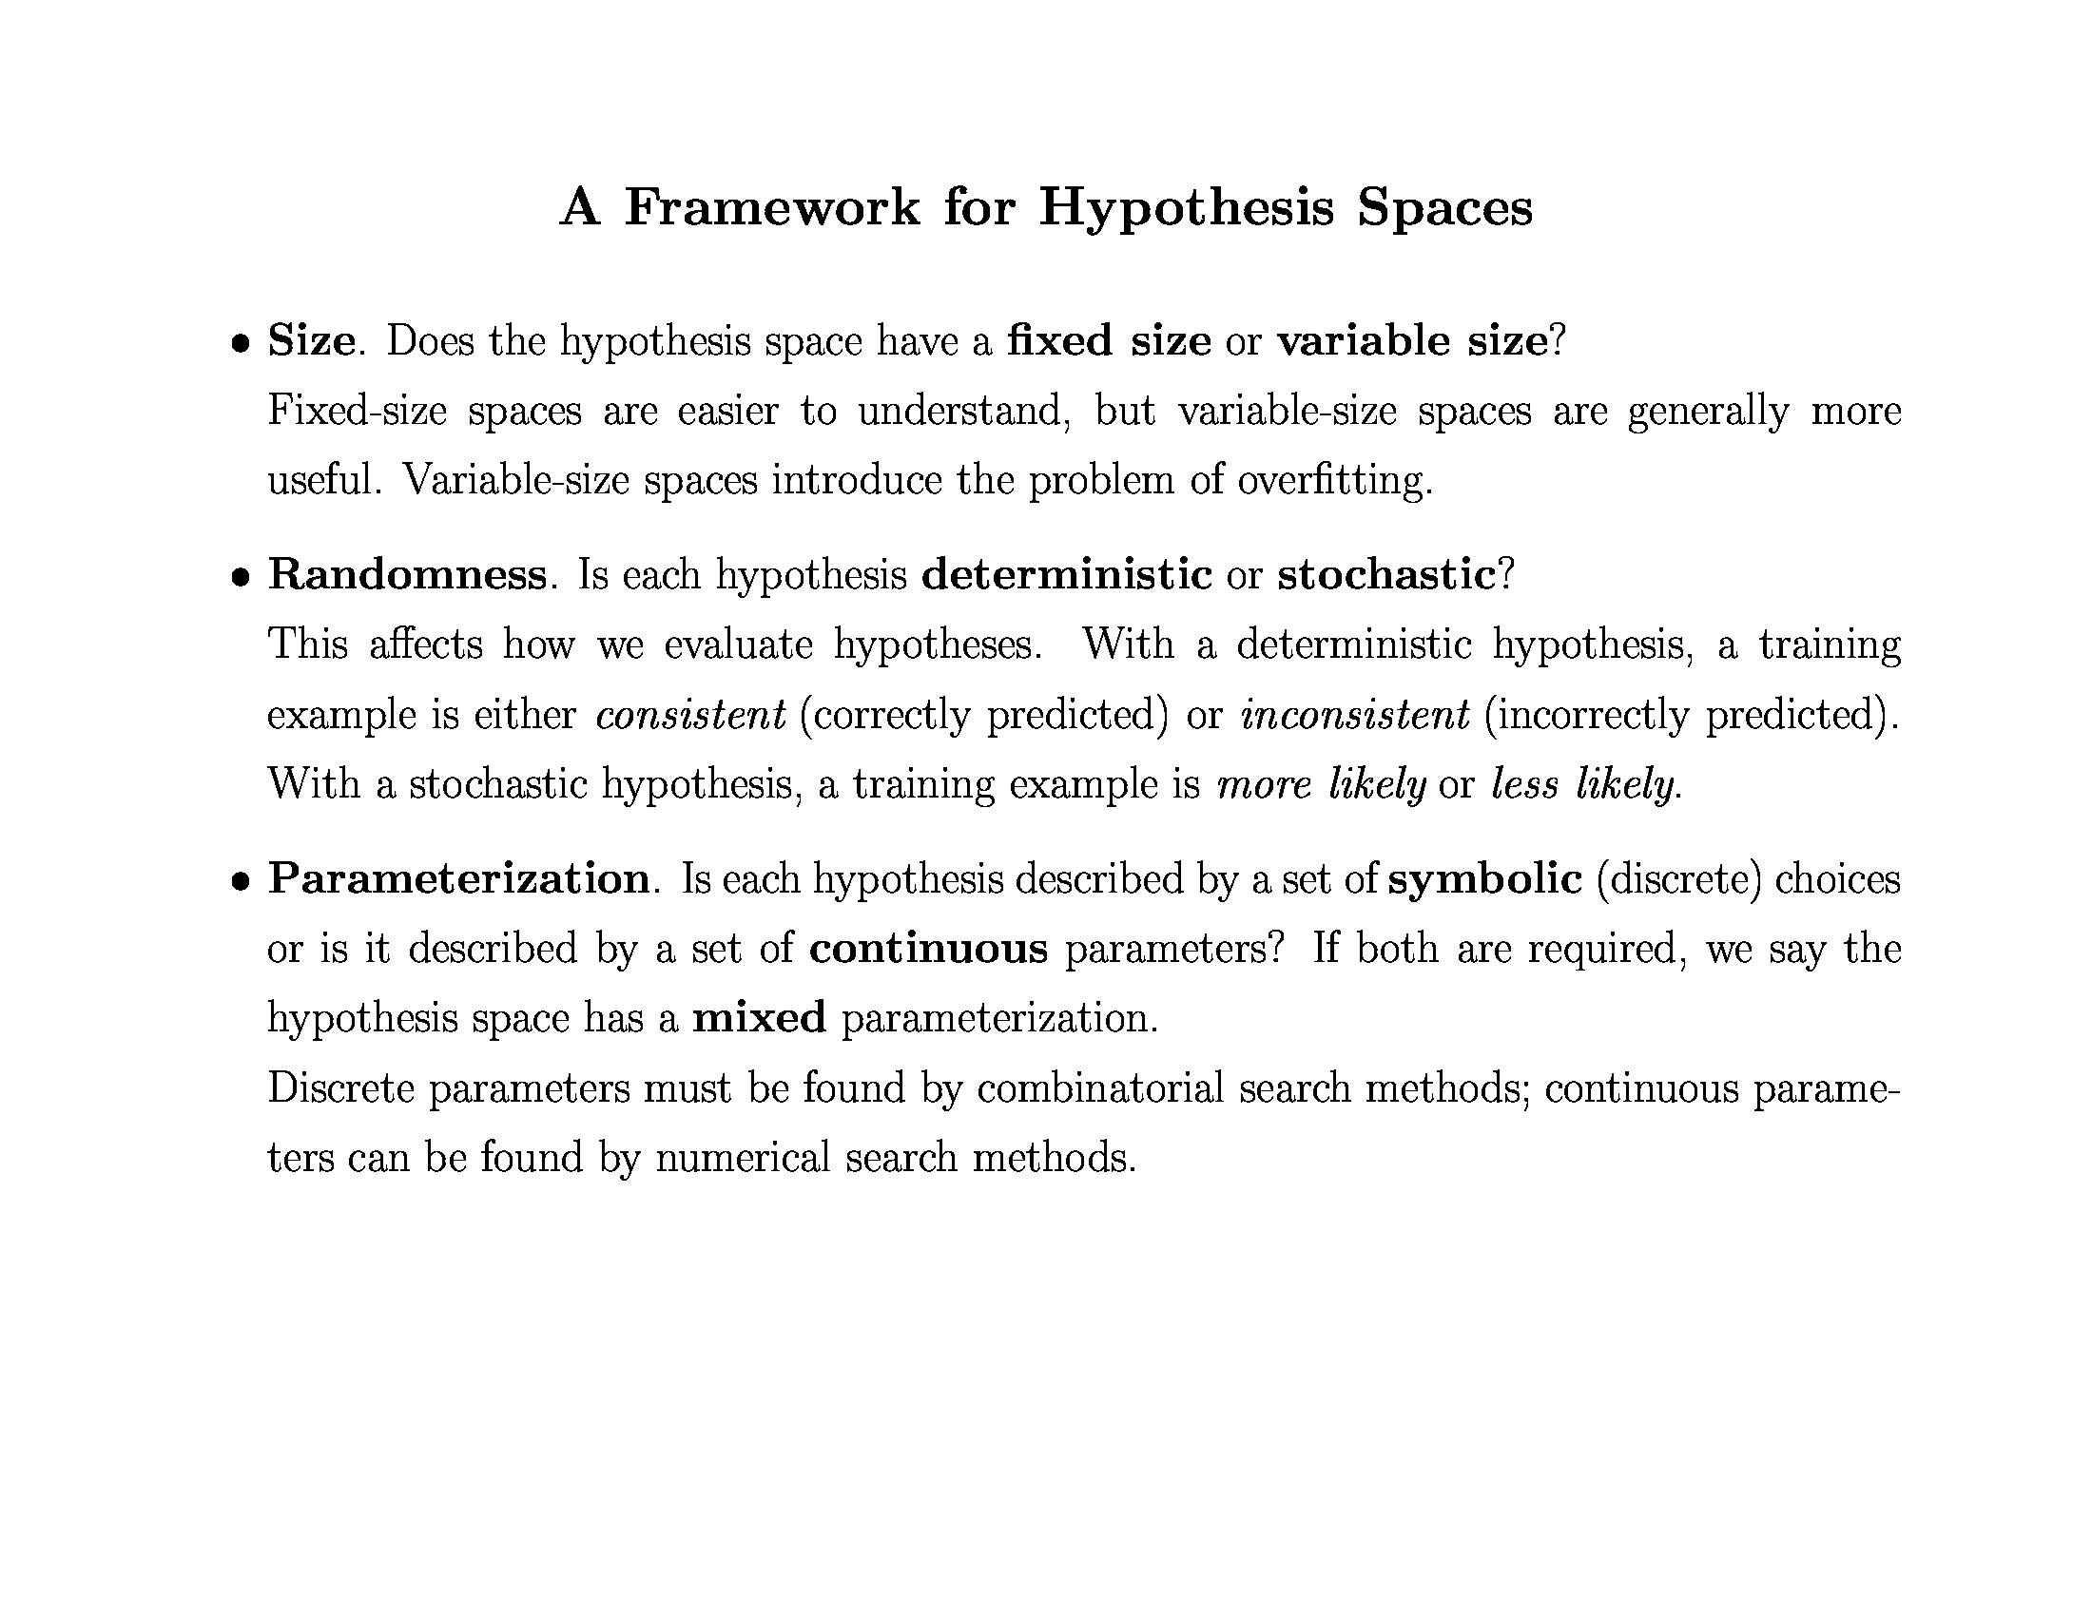
Inductive Learning

Slide 14
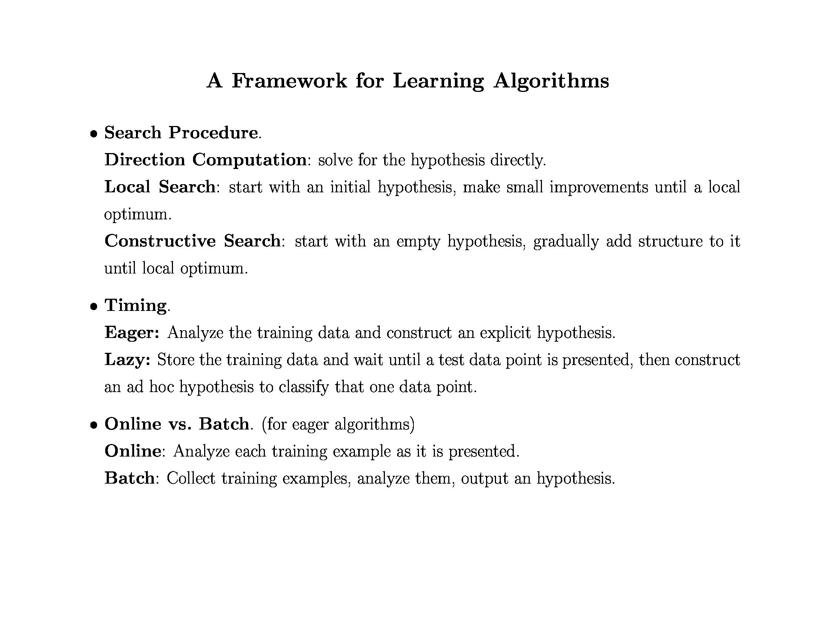
Inductive Learning

Slide 15
Supervised Learning
Lecture 2: Supervised Learning
Outline:
Inductive Learning
Classification, Regression
Decision Trees
Bayesian Learning
Neural Networks
Model Ensembles
Learning Theory
Support Vector Machine
Exercise

